Slide 1
Machine performance
Case study

Slide 2
overview
Data processing
Error types
Modelling

Slide 3
The raw data
Machine Type
Timestamp
Air temperature
Process temperature
Rotational speed- (100 null values)
Torque
Tool wear
Target
Failure Type

Slide 4
Machine Type
There are two machine types in the data X1 and X2, although X1is inconsistently labeled.
With 9900 hours of data for X1 and 100 hours for X2, the data is only useful for analyzing the first type.

Slide 5
Timestamp
Year | Hours
2001 | 731
2002 | 8683
2003 | 486
2011 | 13
2012 | 77
2013 | 10

Slide 6
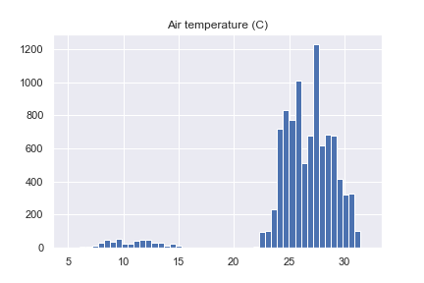
Air Temperature
Distribution indicating possibility of outliers

Slide 7
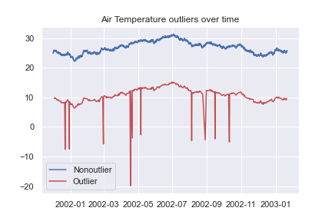
Air temperature
Notable systematic error visible

Slide 8
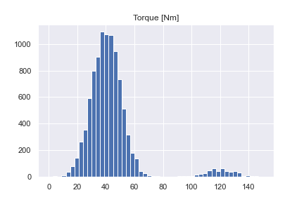
Torque
Similar picture to air temperature

Slide 9
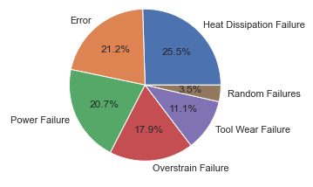
Fault Types
4.46% overall failure rate
396 failures in total

Slide 10
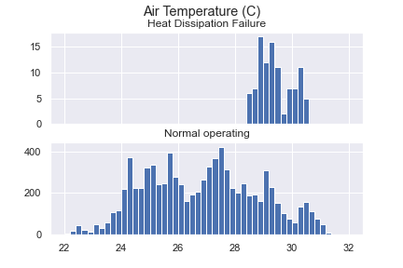
Heat Dissipation Failure
25.5% of failures
99% of these occurred at a higher air temperature than 28.5 ˚C (compared with 23% of normal operating)

Slide 11
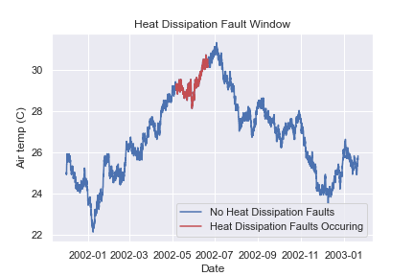
Heat Dissipation Failure
All heat dissipation errors occurred between 6th May 2002 and 21st June 2002
This short window is unique to this type of error

Slide 12
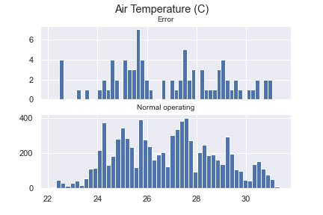
Error
21.2% or faults
Distributions are similar to normal operating
Not marked as Targets

Slide 13
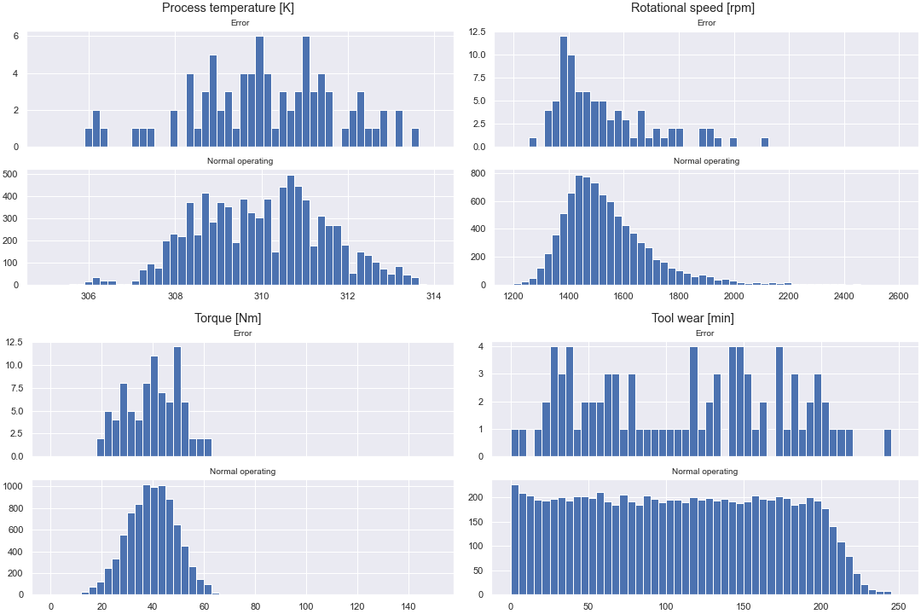

Slide 14
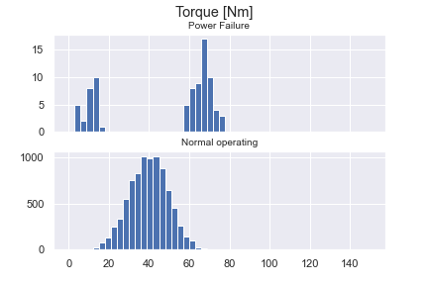
Power Failure
20.7% of failures
Unusual high and low Torque distribution (mirrored in rotational speed)
Possibly two distinct types of failure here

Slide 15
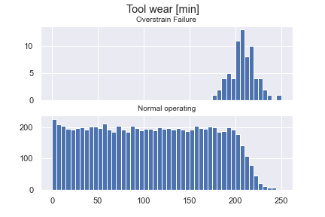
Overstrain Failure
17.9% of failures
Occurring at high tool wear, combined with higher torque and lower rotational speeds
99% of this happened with a tool wear over 181min (compared to 15.7% of normal operation)

Slide 16
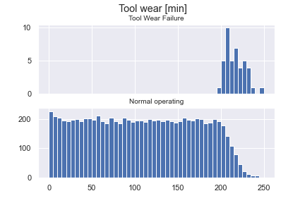
Tool Wear Failure
11.1% of failures
Unsurprisingly occurring at high tool wear
99% of these happened with a tool wear greater than 199min (compared with 7.5% of normal operation)

Slide 17
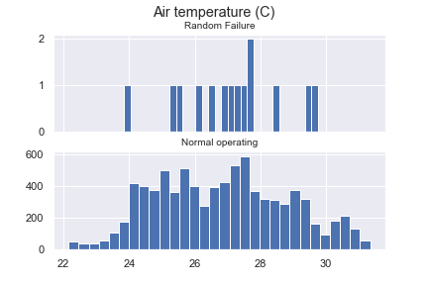
Random Failure
3.5% of failures
Similar situation to the “Error” failure type

Slide 18
To recap…
Investigate why heat dissipation faults happened in a short window and consider added cooling for warmer conditions
Investigate the “Error” failure type (are they actually faults?)
Consider placing stricter limits on tool wear as a measure to reduce overstrain and tool wear faults (accounting for 29% of faults in total)

Slide 19
Modelling
Fault identification: Using state of machine to determine type of current fault (if any)
Fault prediction: monitoring features over time to predict if a fault will occur

Slide 20
Fault identification
As a proof of concept, I trained a random forest classifier. Comparing macro F1 score with a dummy we see
Dummy F1 score: 0.140
Random Forest F1 score: 0.472
(both on a holdout test set)

Slide 21
Any Questions?

Slide 22
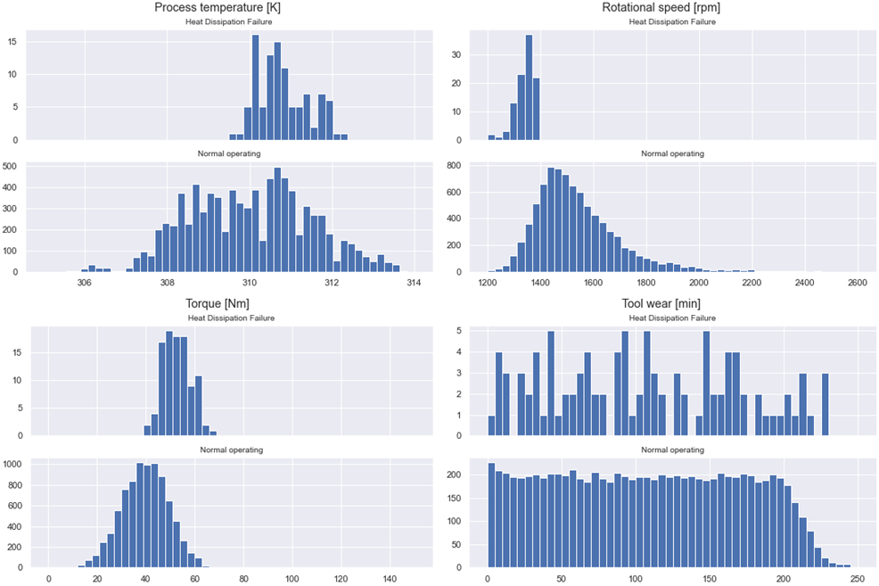
Heat dissipation Faults

Slide 23
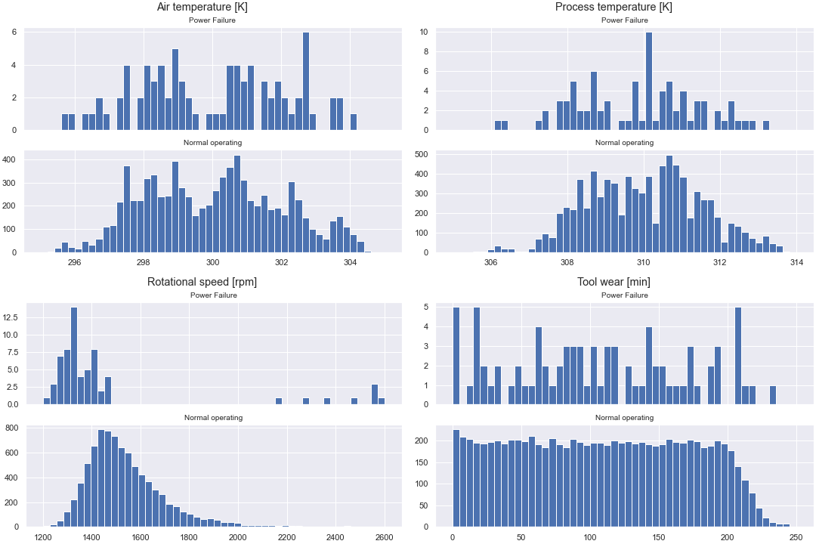
Power Failure

Slide 24
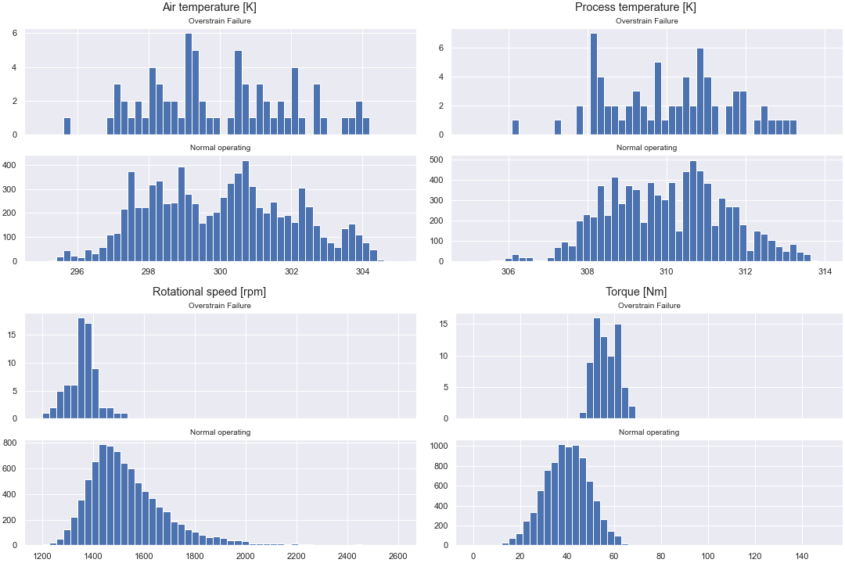
Overstrain Failure

Slide 25
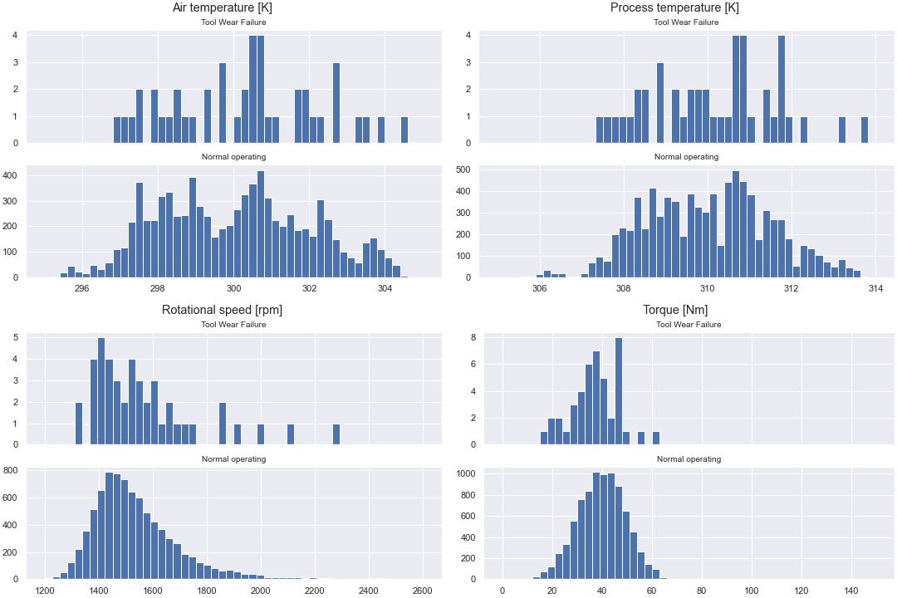
Tool Wear error

